Slide 1
Dataset Analysis

Slide 2
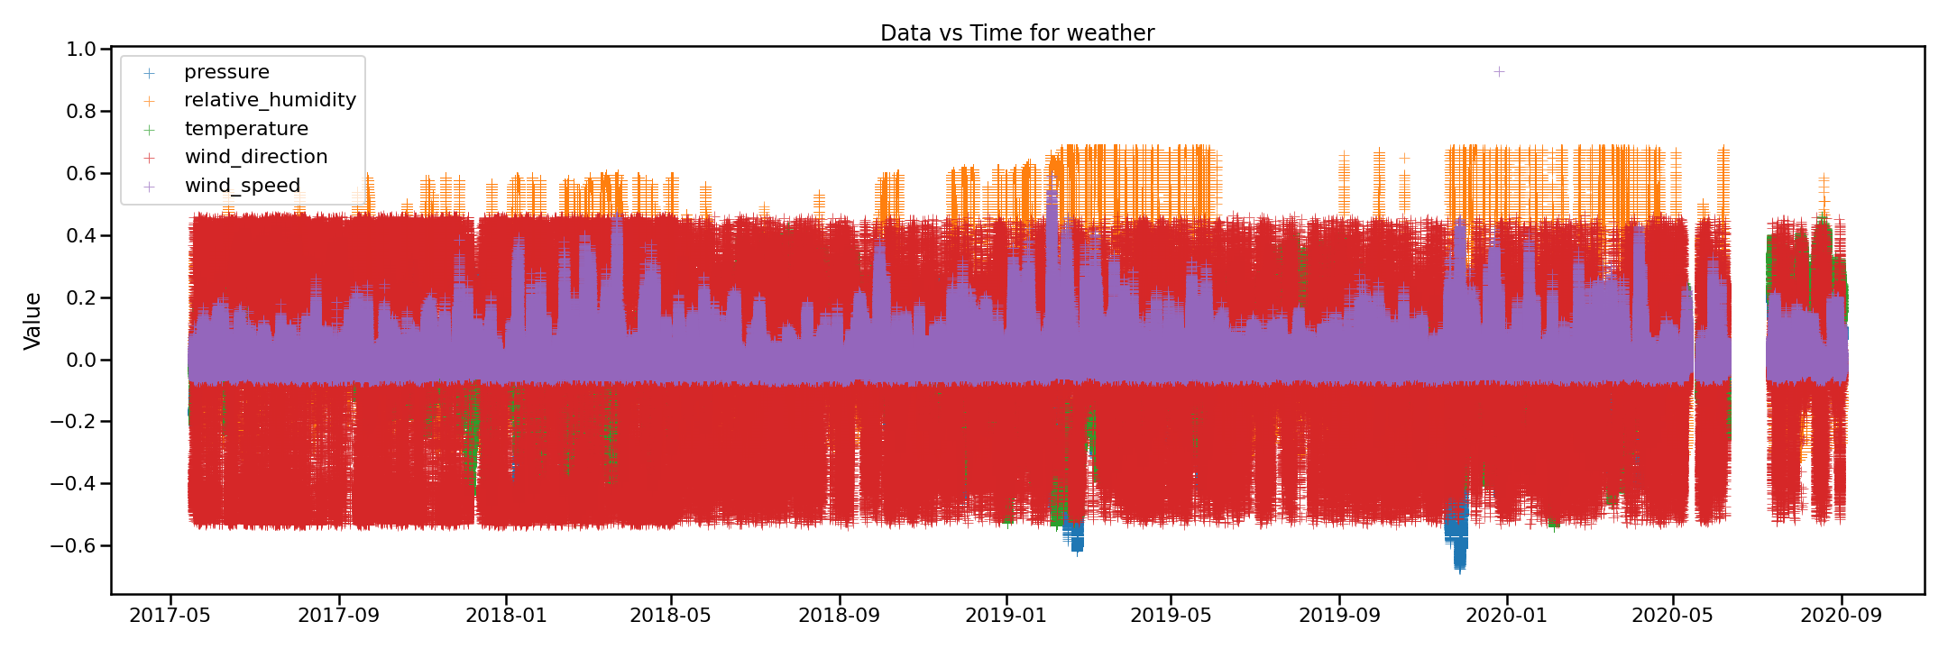
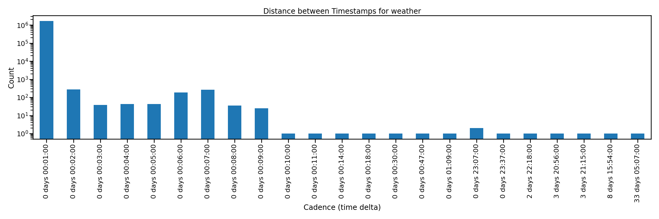
Weather
Ranges: 2017-05-17 19:36:00
to 2020-09-01 17:05:00
Mean cadence = 00:01:03.045
The Data vs Time plot to the right is normalized.

Slide 3
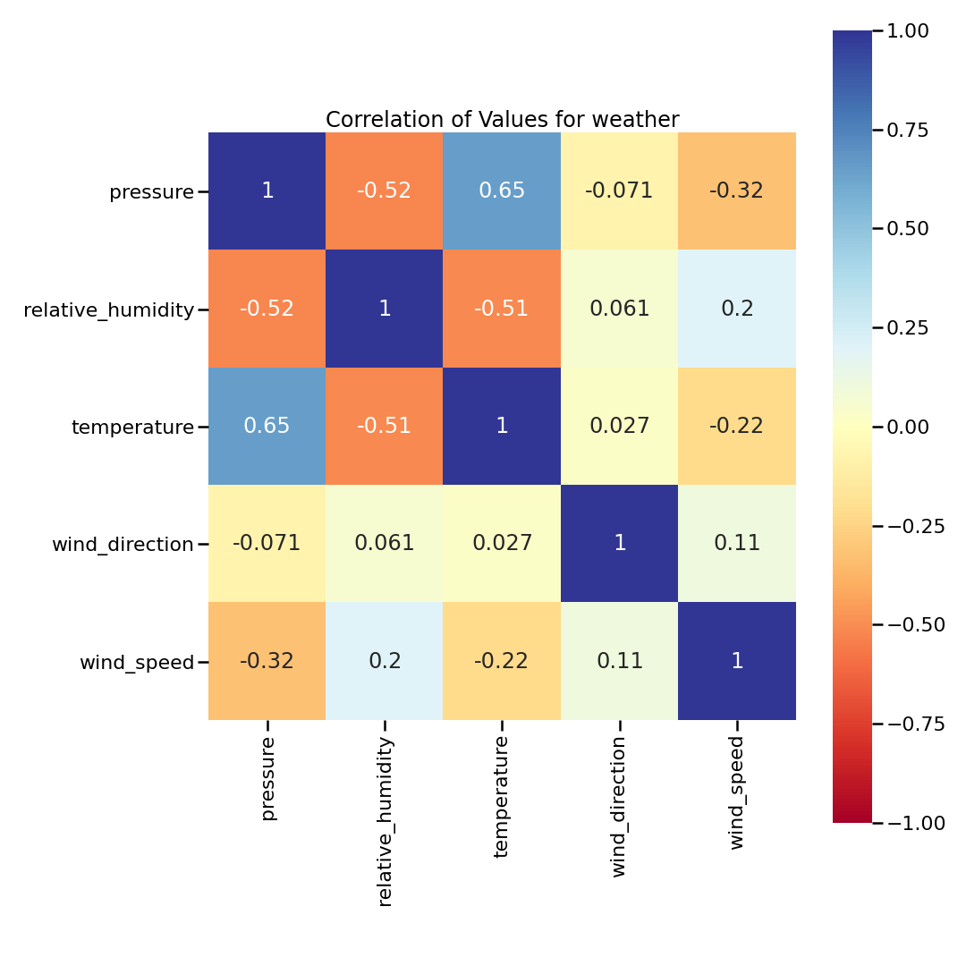
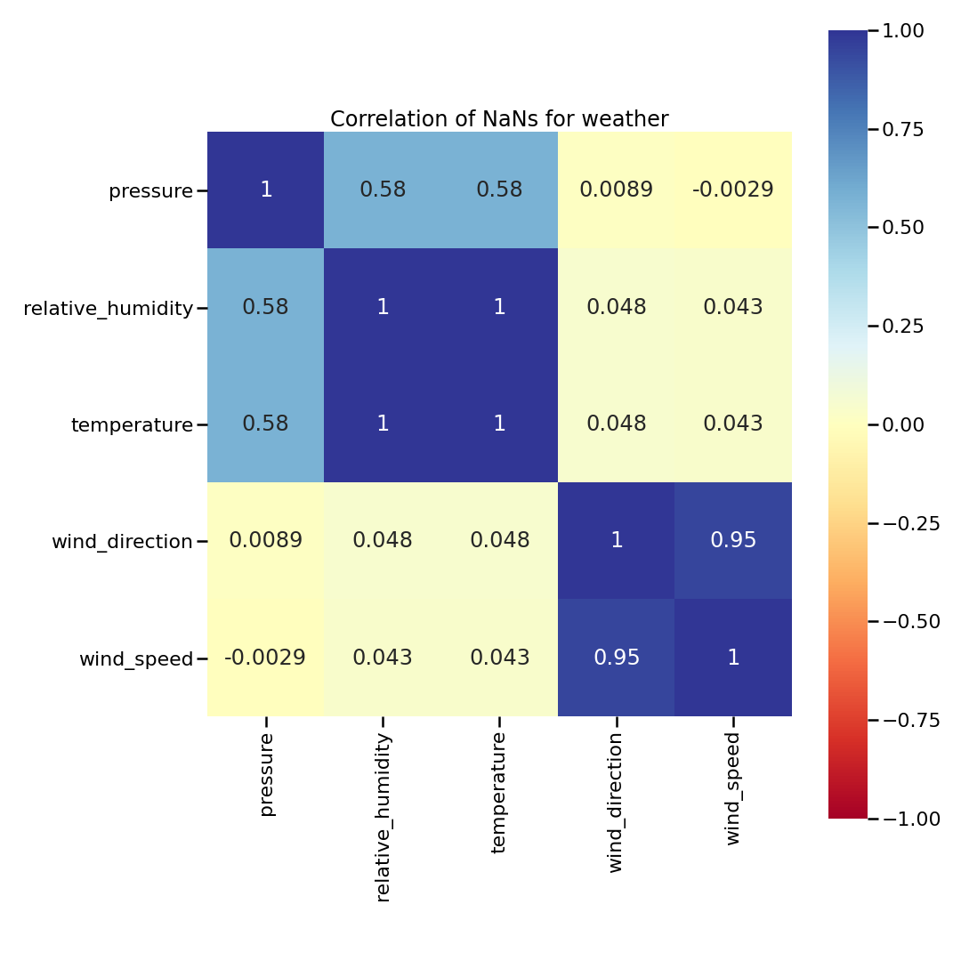
Weather

Slide 4
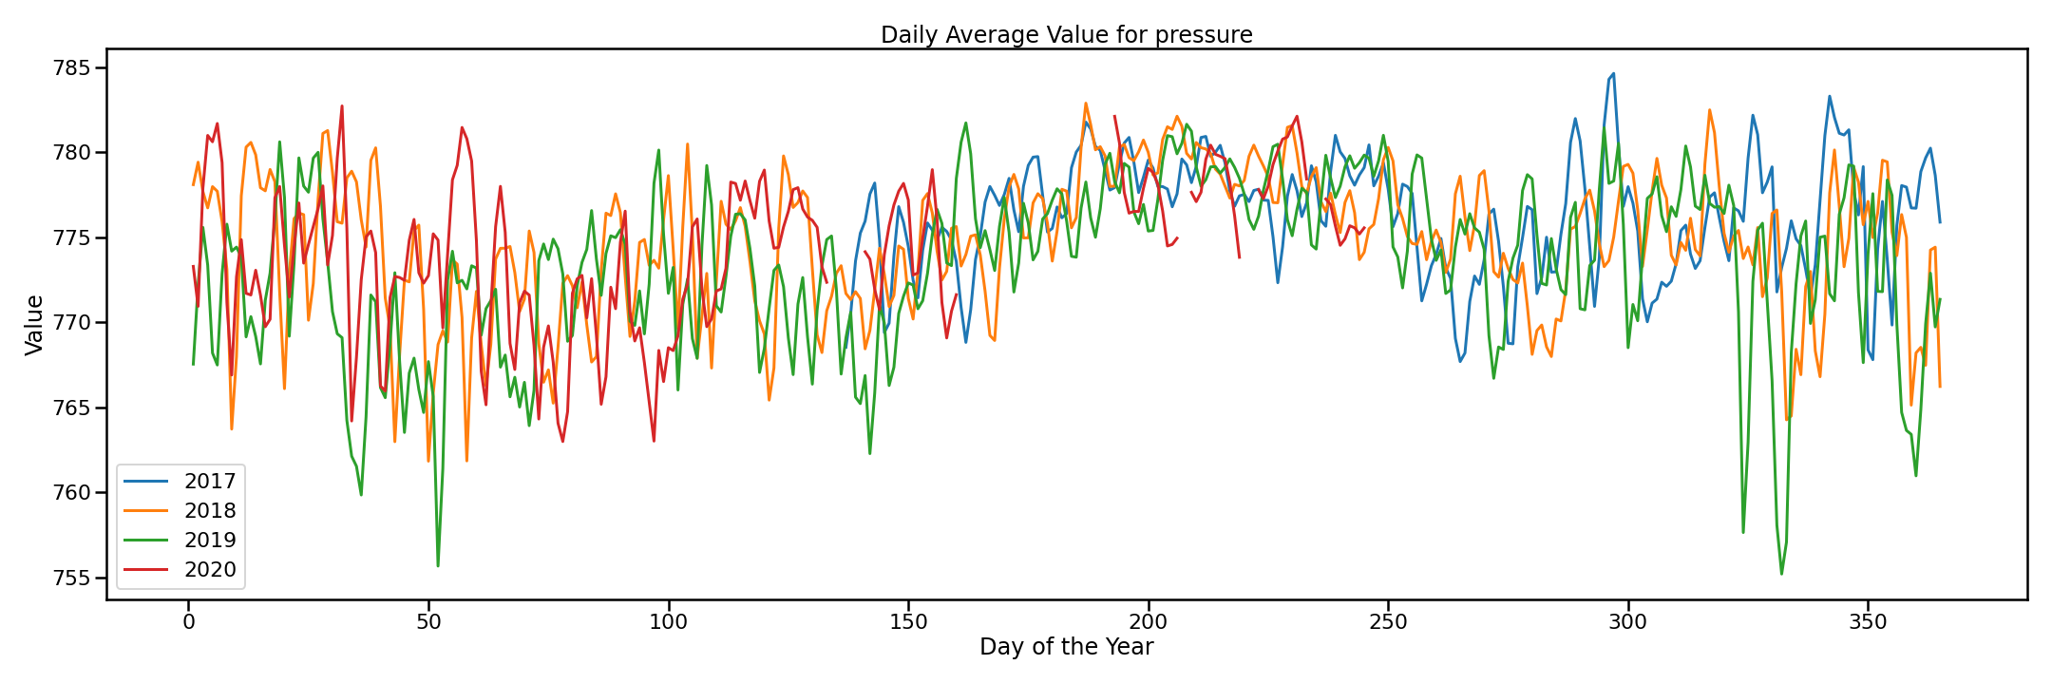
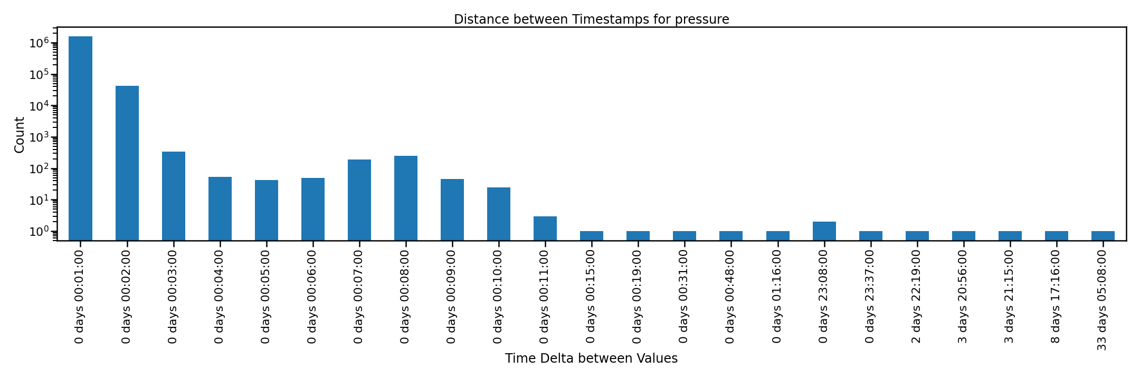
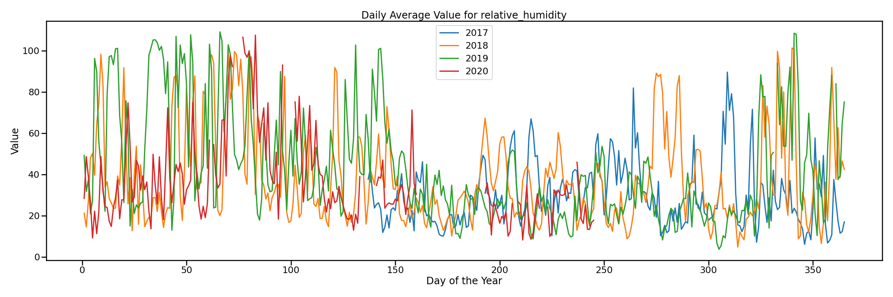
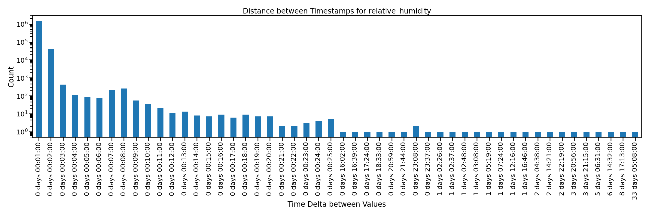
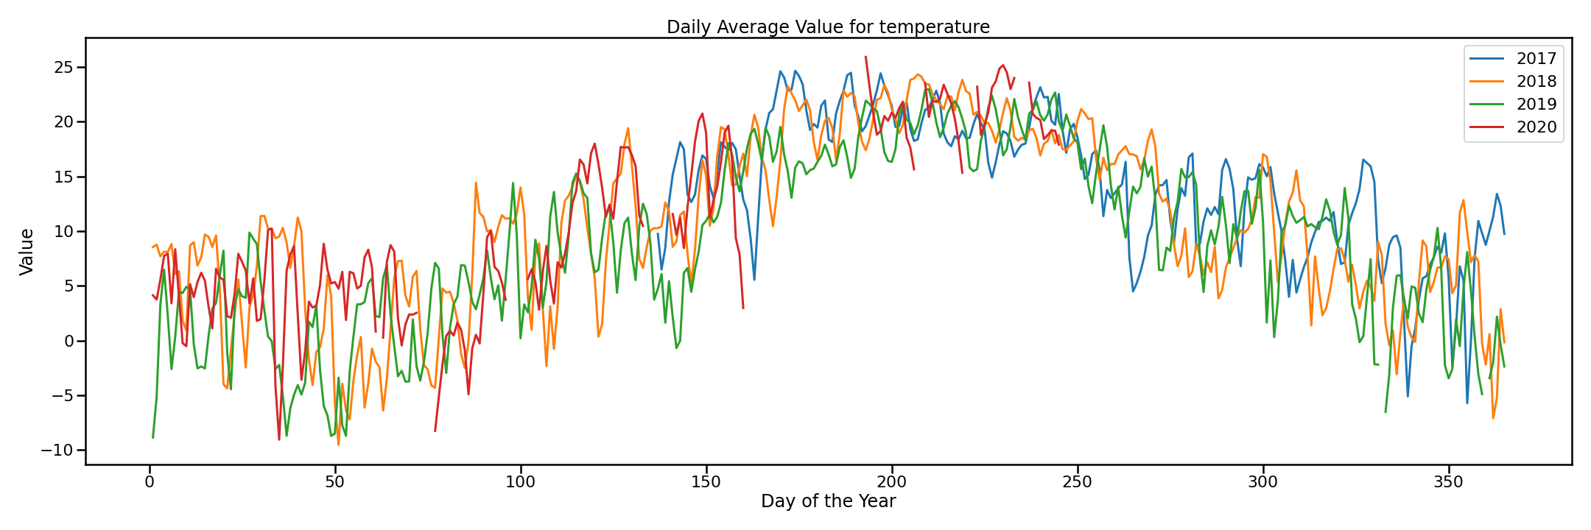
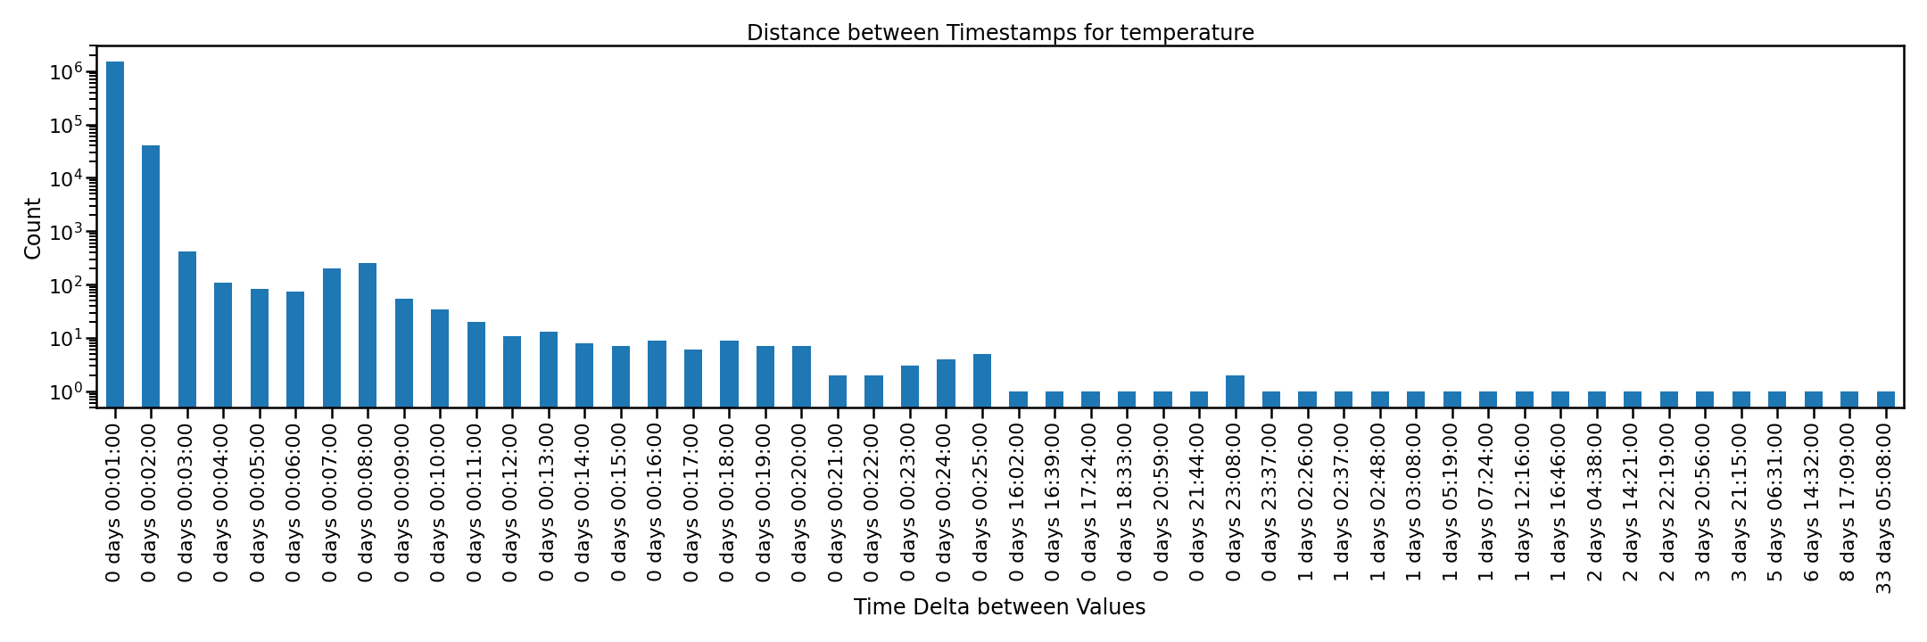
Weather

Slide 5
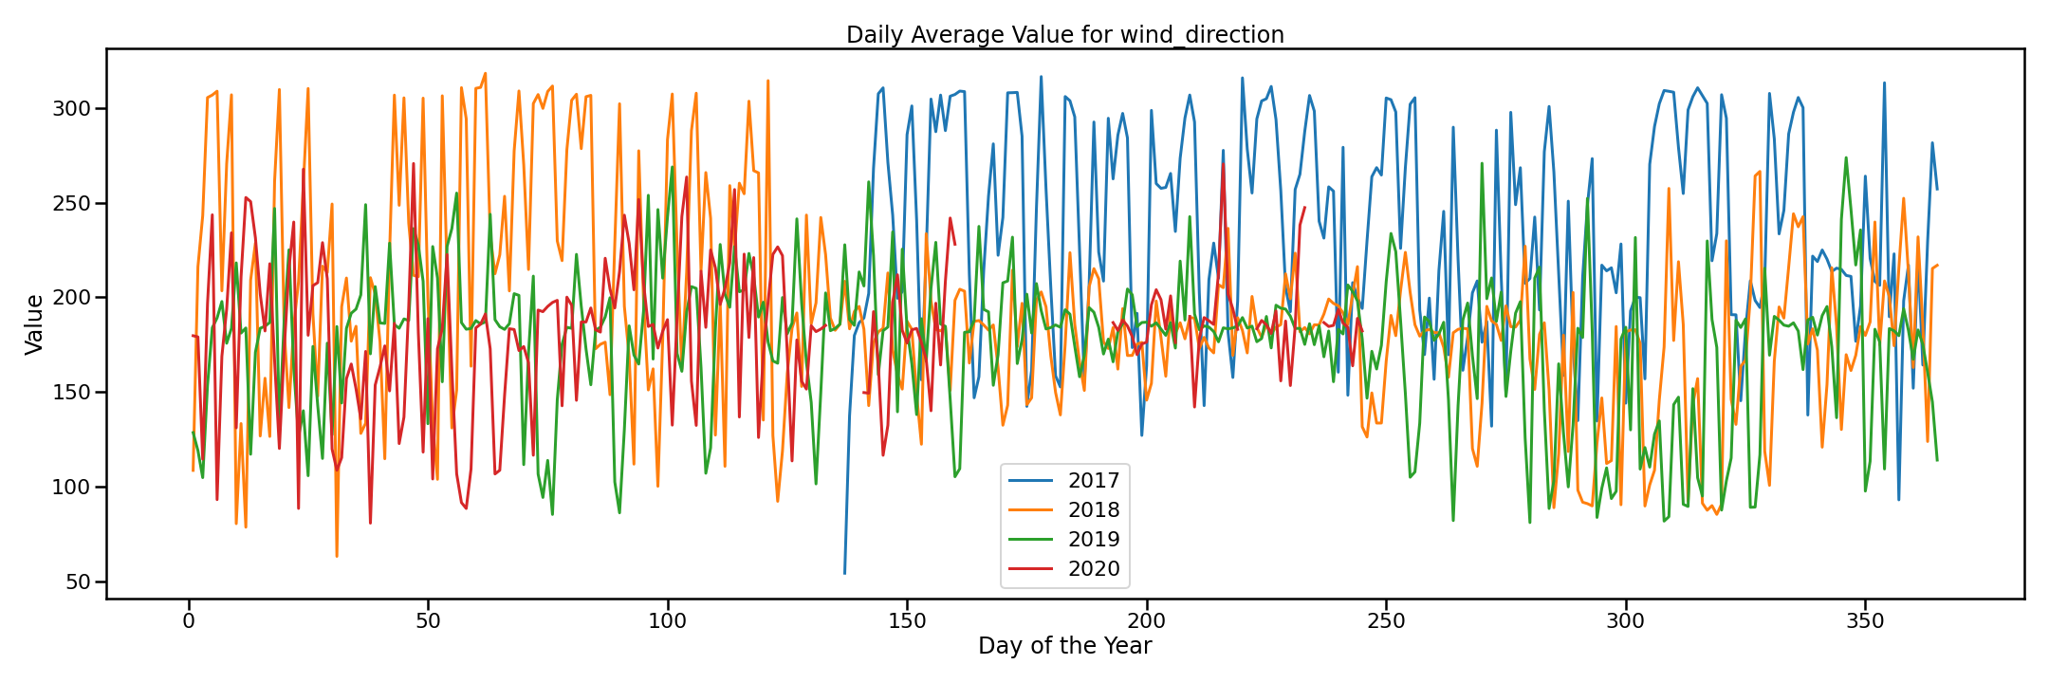
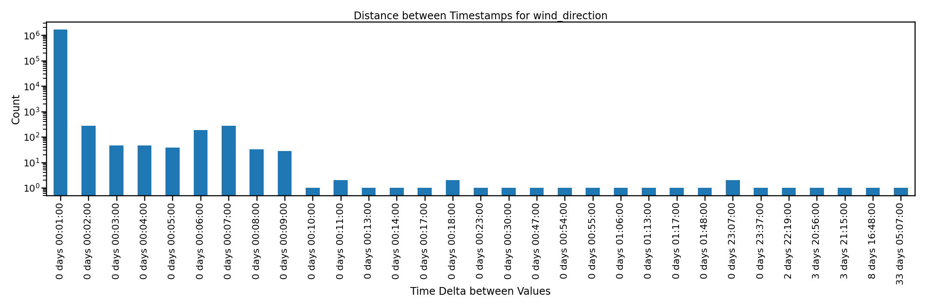
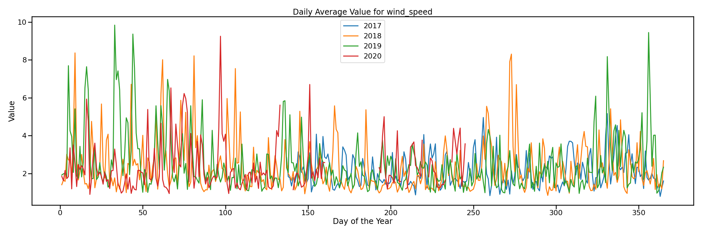
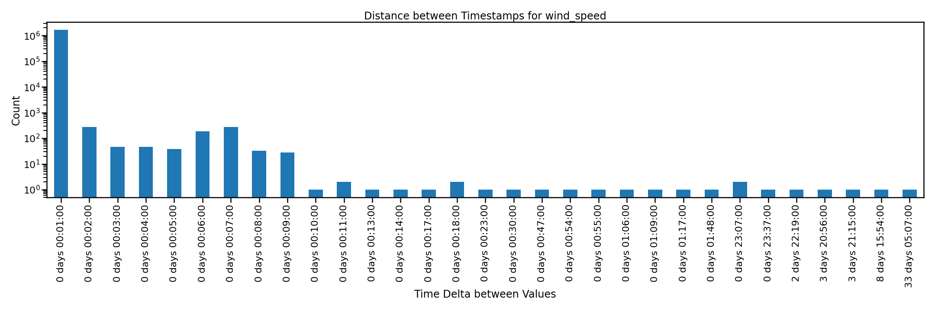
Weather
pressure rel humidity temperature wind direction wind_speed
percent 97.4115 92.5694 92.5696 99.9657 99.9692
total 1648505 1648505 1648505 1648505 1648505
value count 1605834 1526011 1526015 1647939 1647997
nan count 42671 122494 122490 566 508
cadence mean 00:01:04.72 00:01:08.11 00:01:08.11 00:01:03.067 00:01:03.06
The stats to the right show the value and nan counts for each column. The percent row is the density percent of the column.

Slide 6
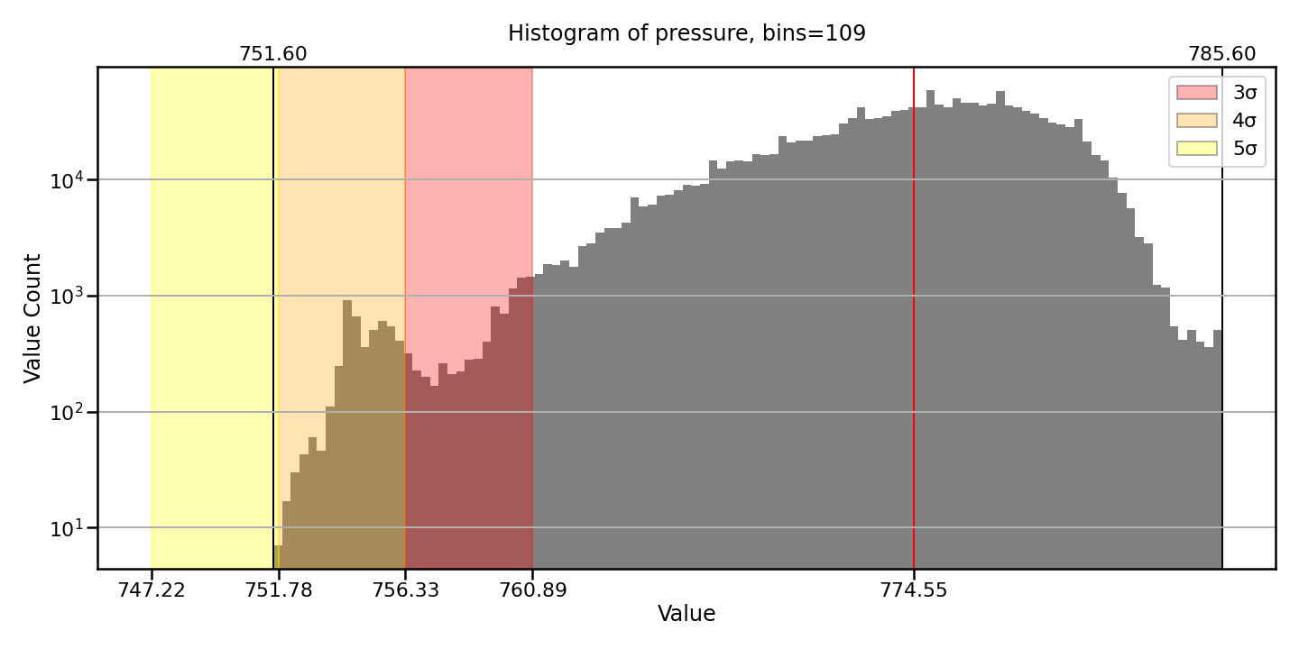
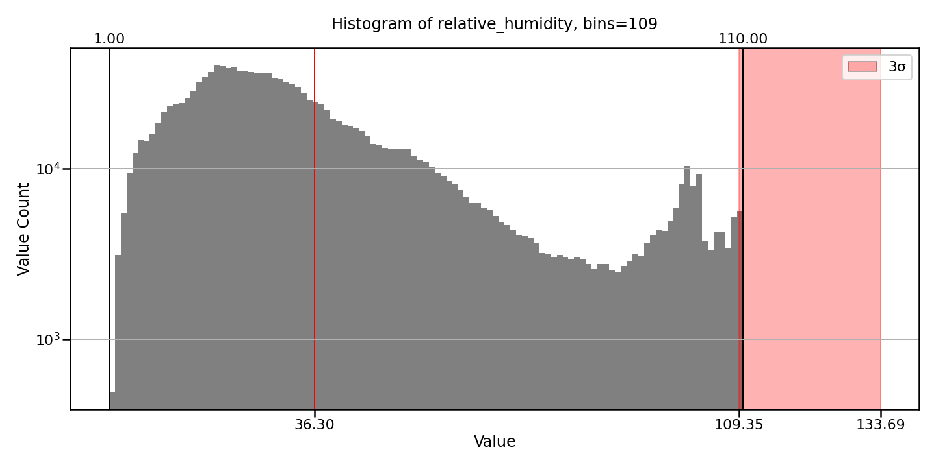
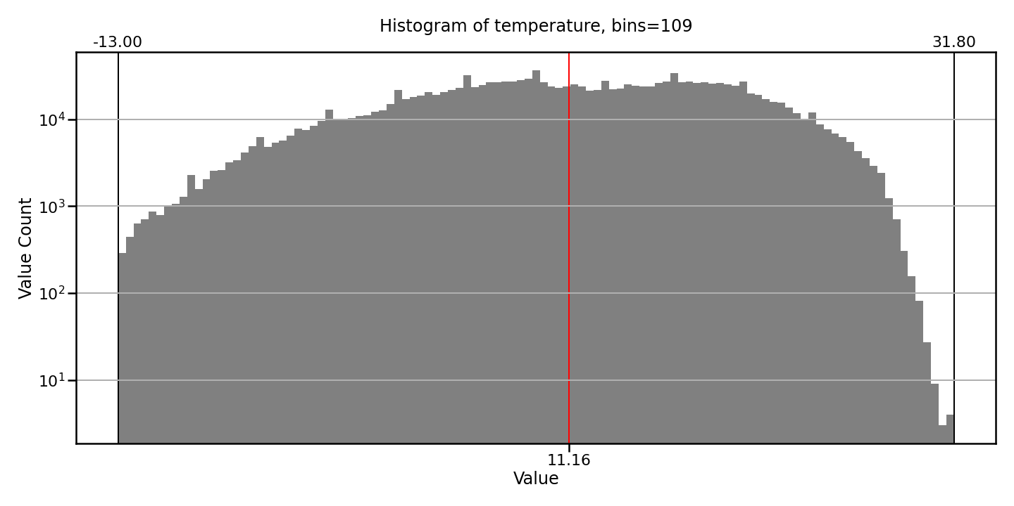
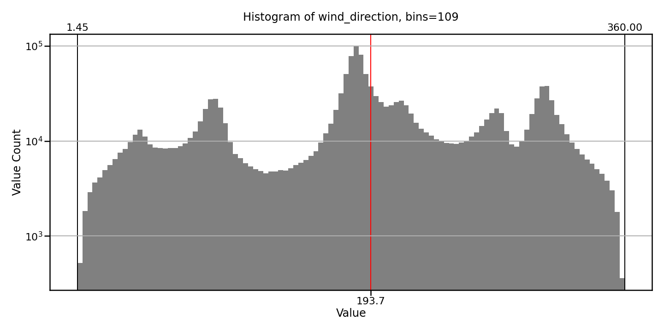
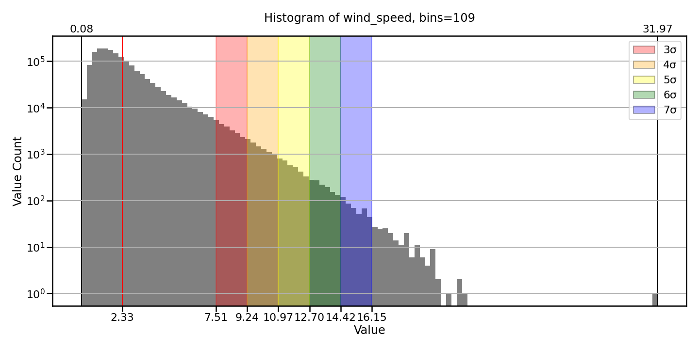
Weather
Only sigma regions between 3 sigma and 7 sigma are highlighted.
The red line is the mean for the series, while the black lines at each edge are the min and max. The upper x-ticks are the min/max, while the lower x-ticks are the sigma values.

Slide 7
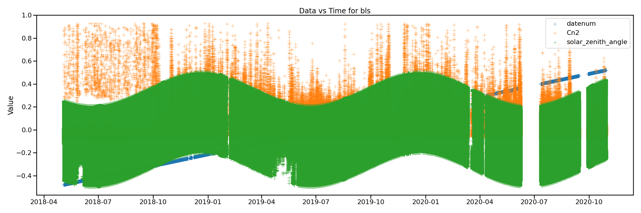
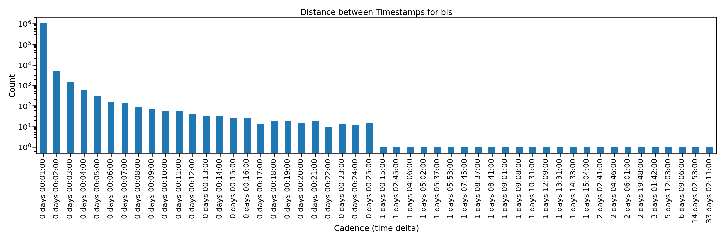
BLS
Ranges: 2018-05-03 20:36:00
to 2020-10-29 18:45:00
Mean cadence = 00:01:04.35 The Data vs Time plot to the right is normalized.
A cadence of 00:00:00 implies duplicate timestamps.

Slide 8
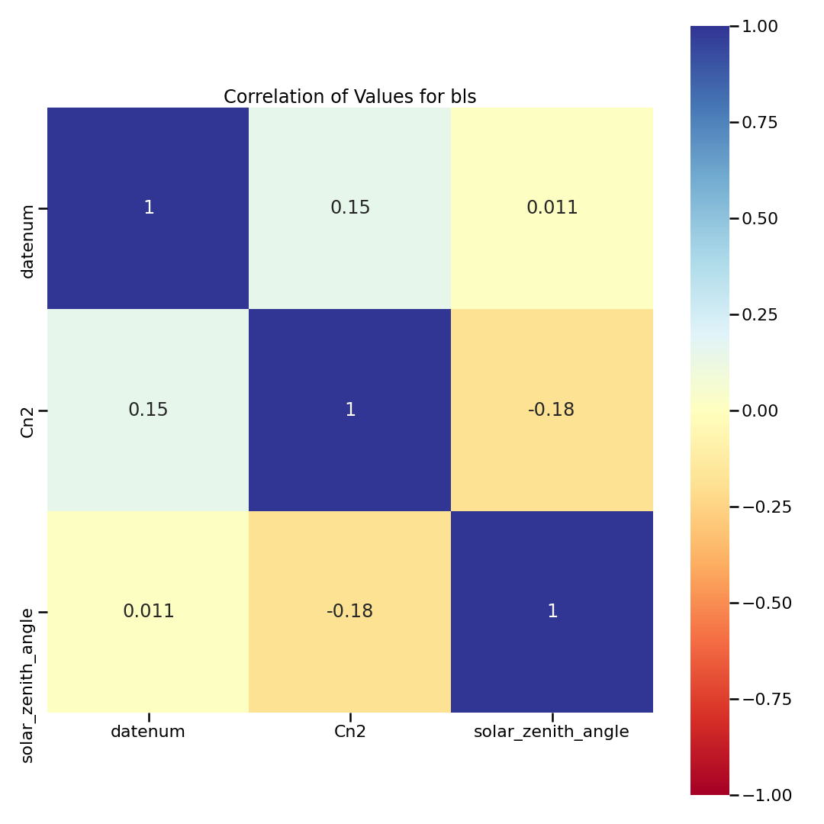
BLS
There were no NaNs in the columns so there is no NaN correlation heatmap

Slide 9
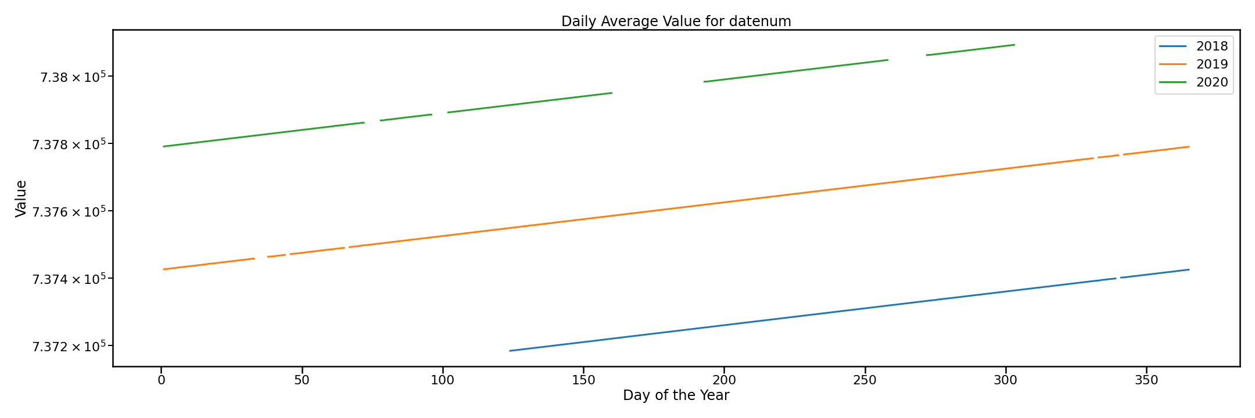
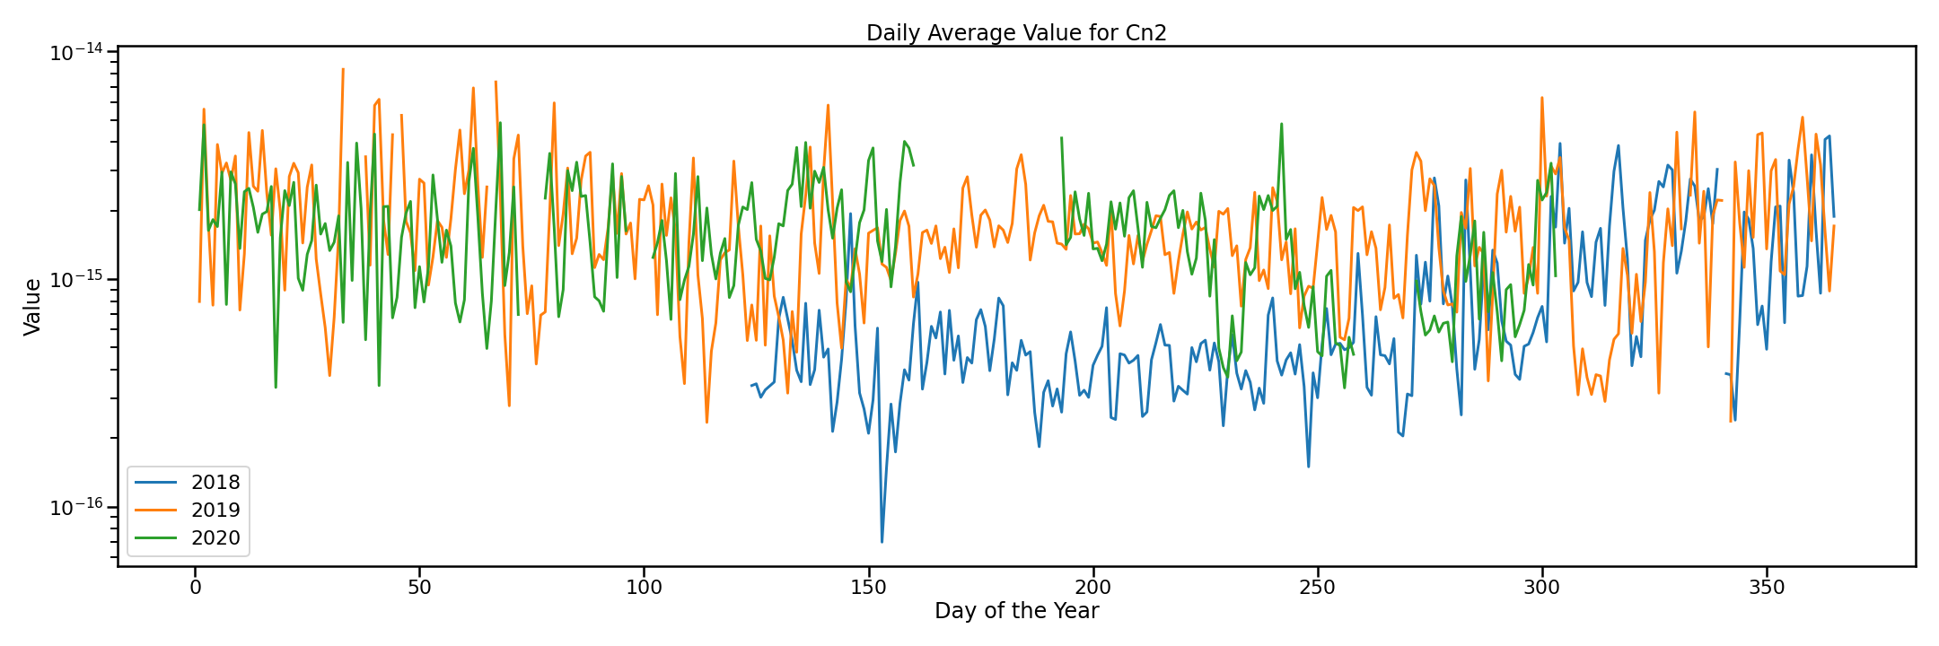
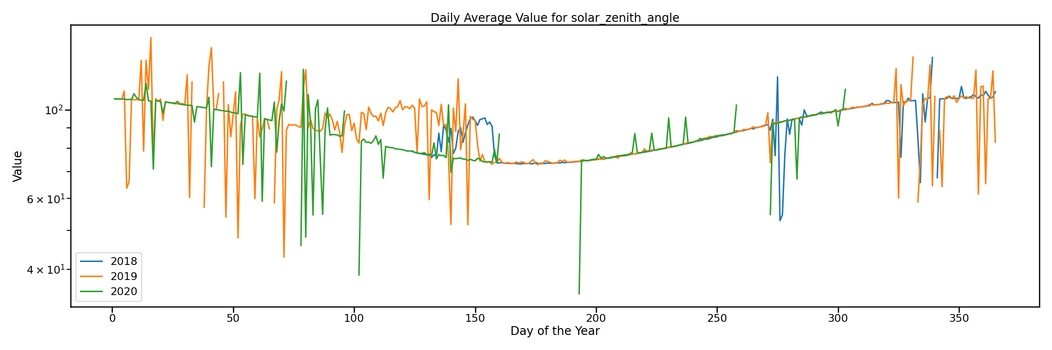
BLS
Daily average values for each year per column. The plot to the right is the Matlab datenum column which makes it easy to see where the gaps in the data are for each year.

Slide 10
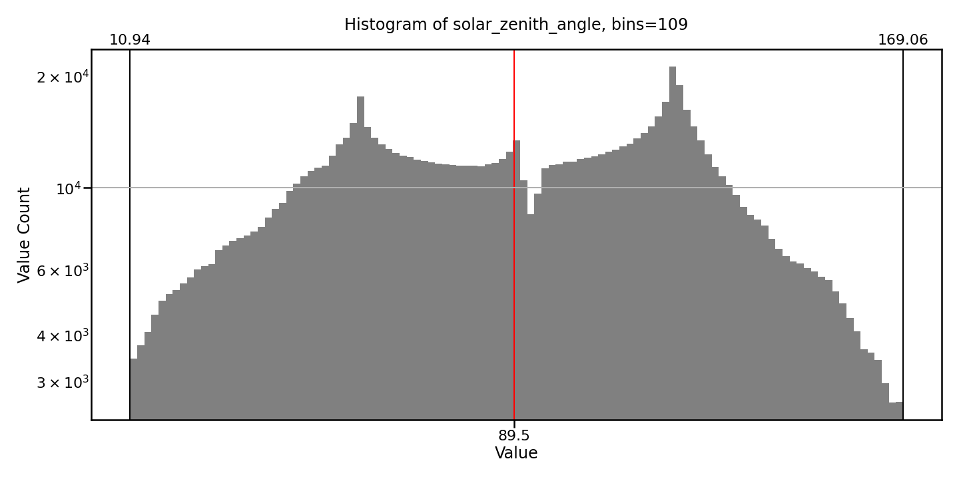
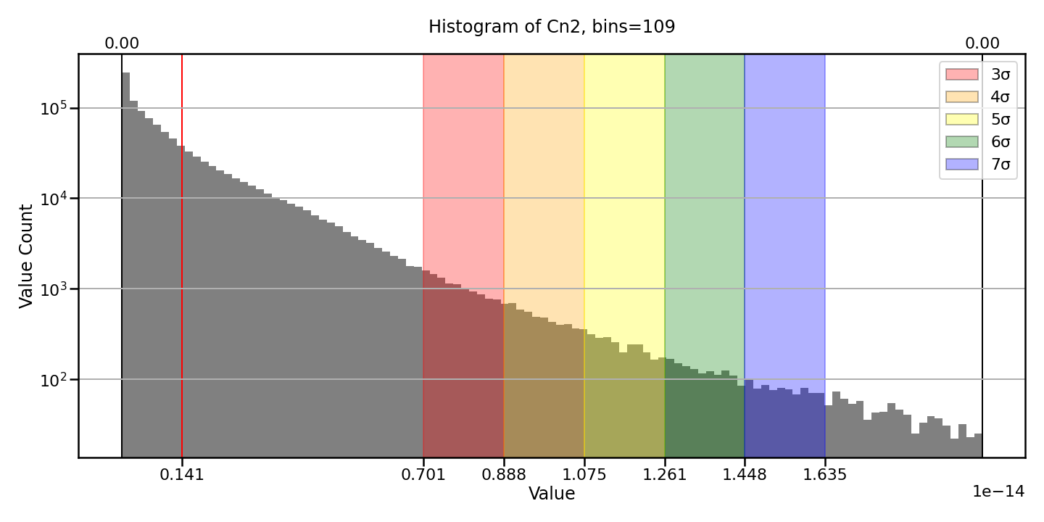
BLS
Only sigma regions between 3 sigma and 7 sigma are highlighted.
The red line is the mean for the series, while the black lines at each edge are the min and max. The upper x-ticks are the min/max, while the lower x-ticks are the sigma values.
The stats below show the value and nan counts for each column. The percent row is the density percent of the column.
Cn2 solar_zenith_angle
percent 100 100
total 1070931 1070931
value count 1070931 1070931
nan count 0 0
cadence mean 00:01:13.40 00:01:13.40

Slide 11
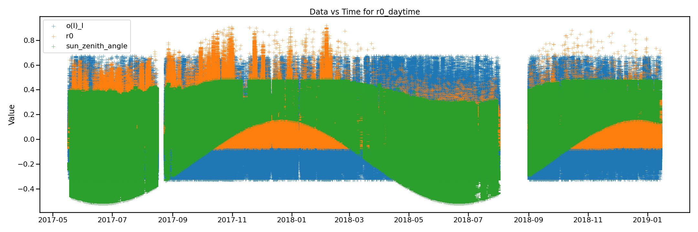
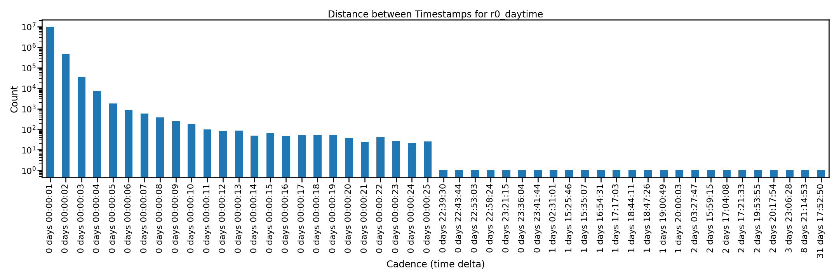
R0 Day
Ranges: 2017-05-17 21:42:23
to 2019-01-13 20:29:19
Mean cadence = 00:00:05.058
The Data vs Time plot to the right is normalized.

Slide 12
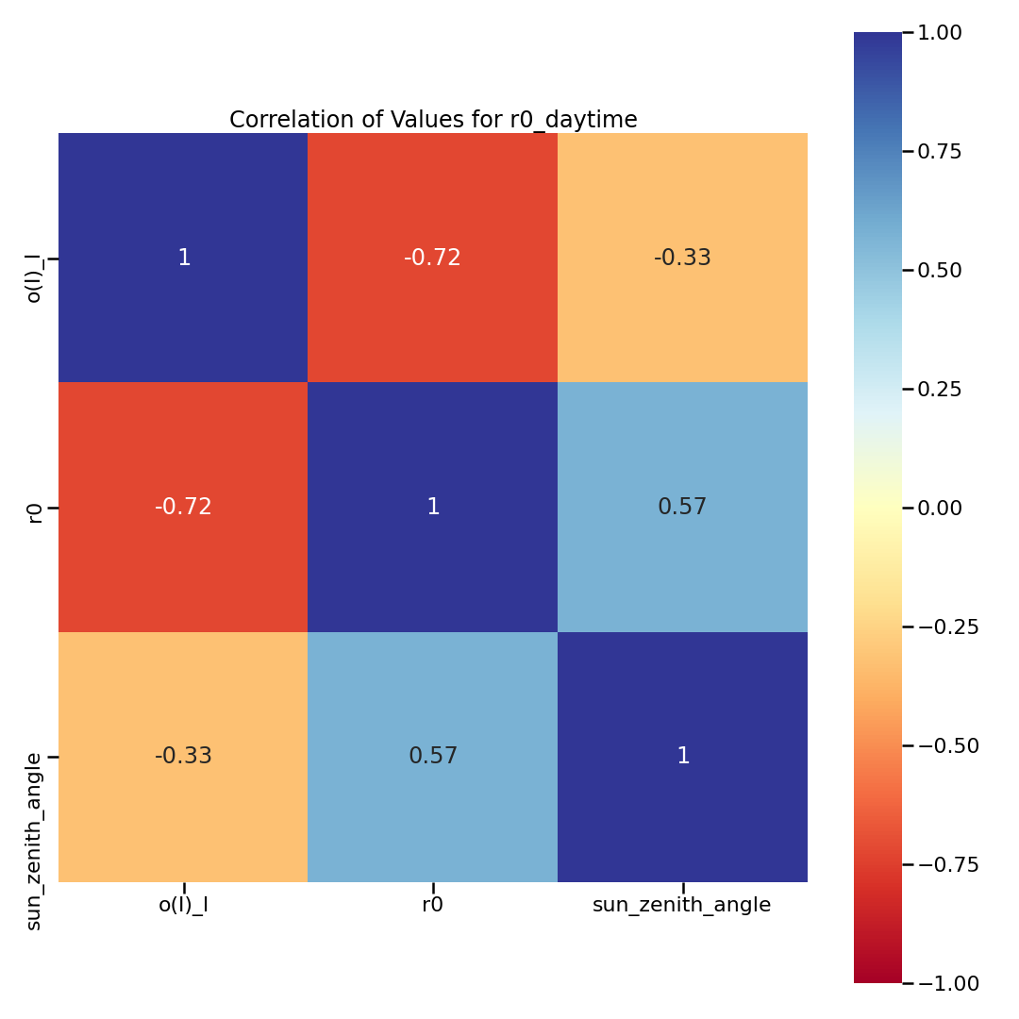
R0 Day
There were no NaNs in the columns so there is no NaN correlation heatmap
The stats below show the value and nan counts for each column. The percent row is the density percent of the column.
o(I)_I r0 sun_zenith_angle
percent 100 100 100
total 10350049 10350049 10350049
value count 10350049 10350049 10350049
nan count 0 0 0
cadence mean 00:00:05.06 00:00:05.06 00:00:05.06

Slide 13
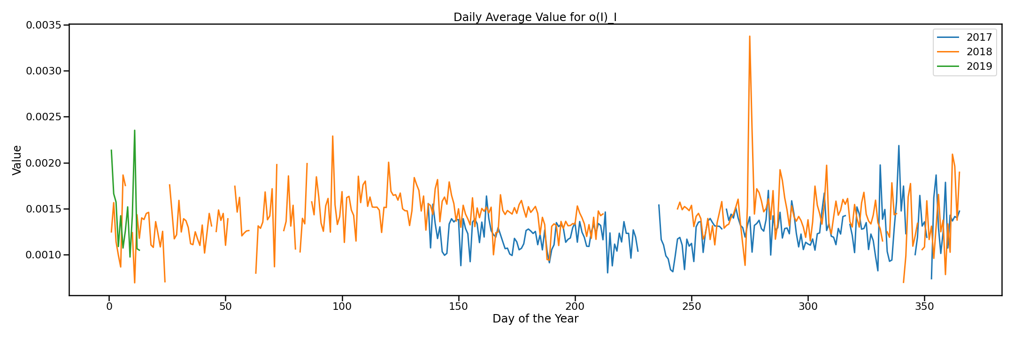
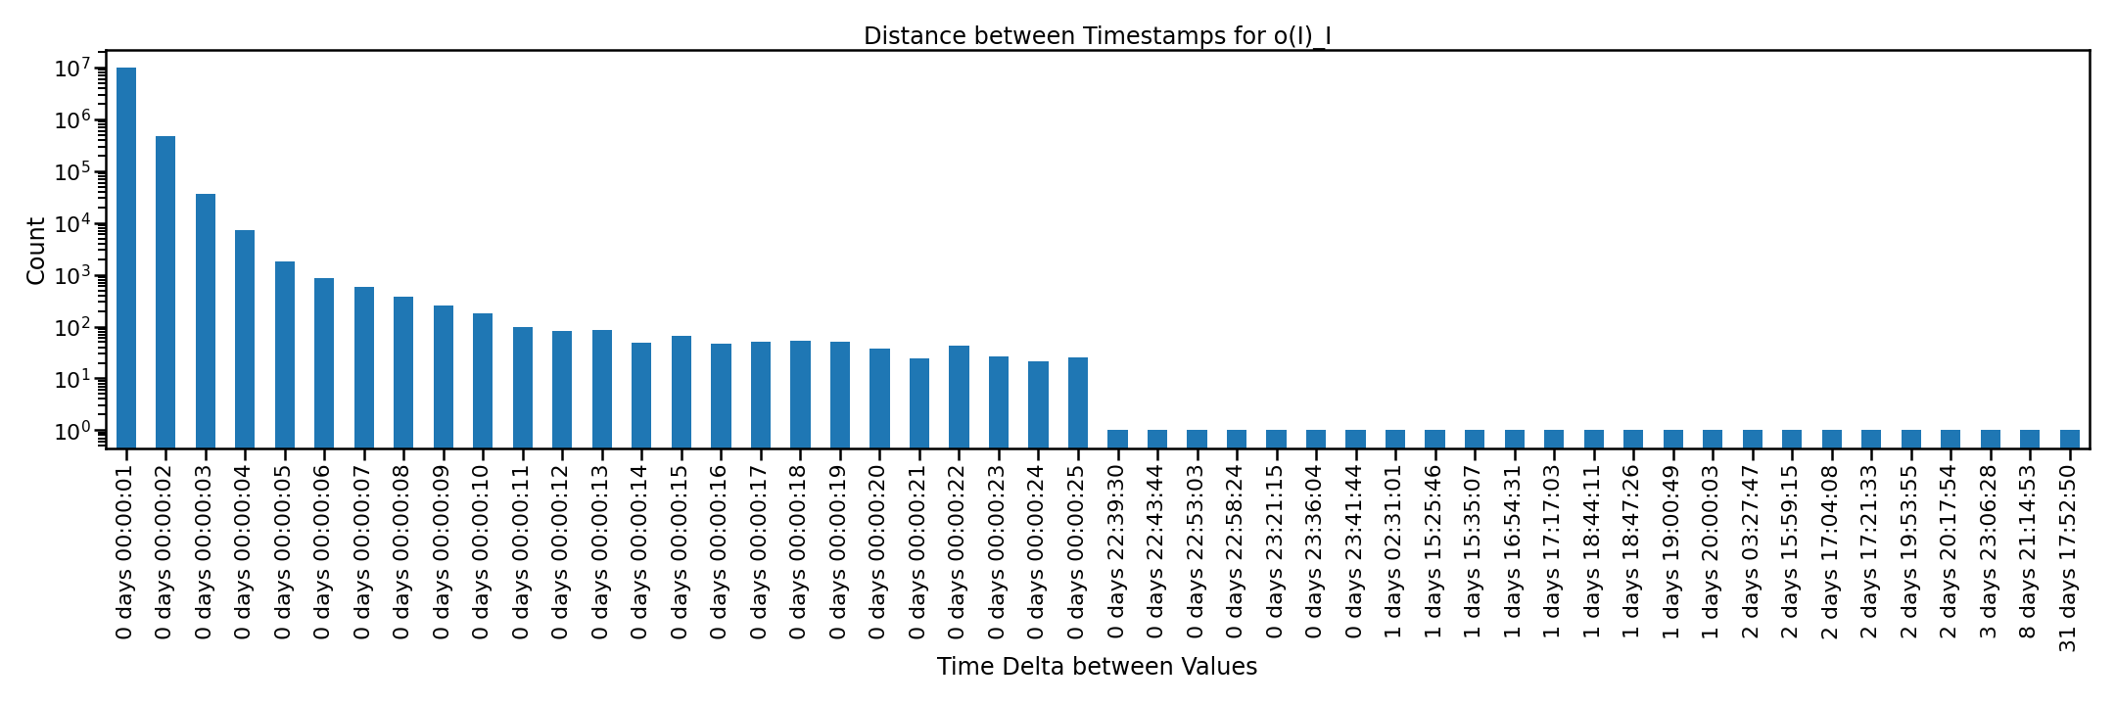
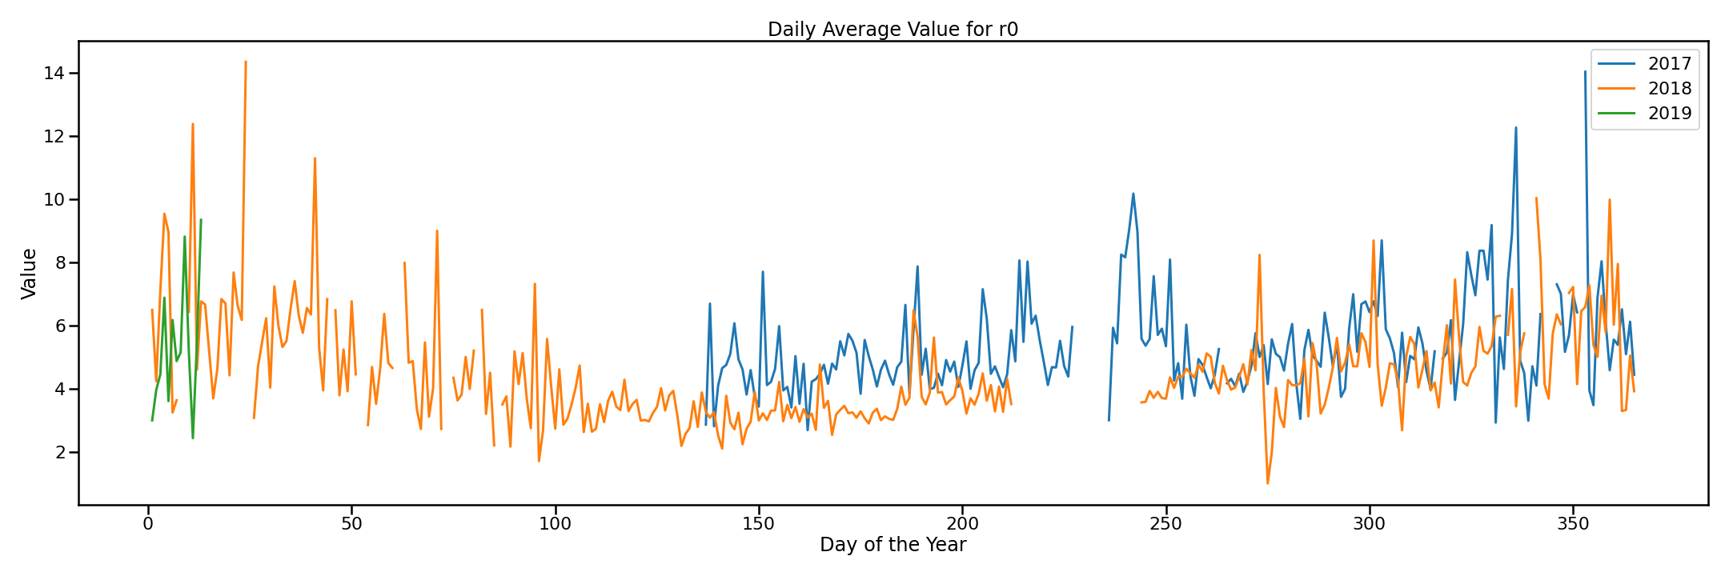

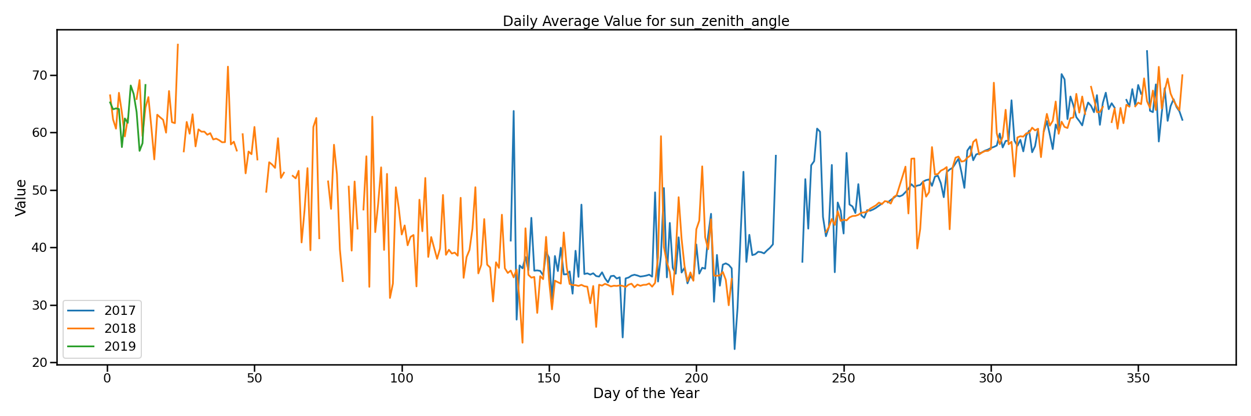

R0 Day

Slide 14
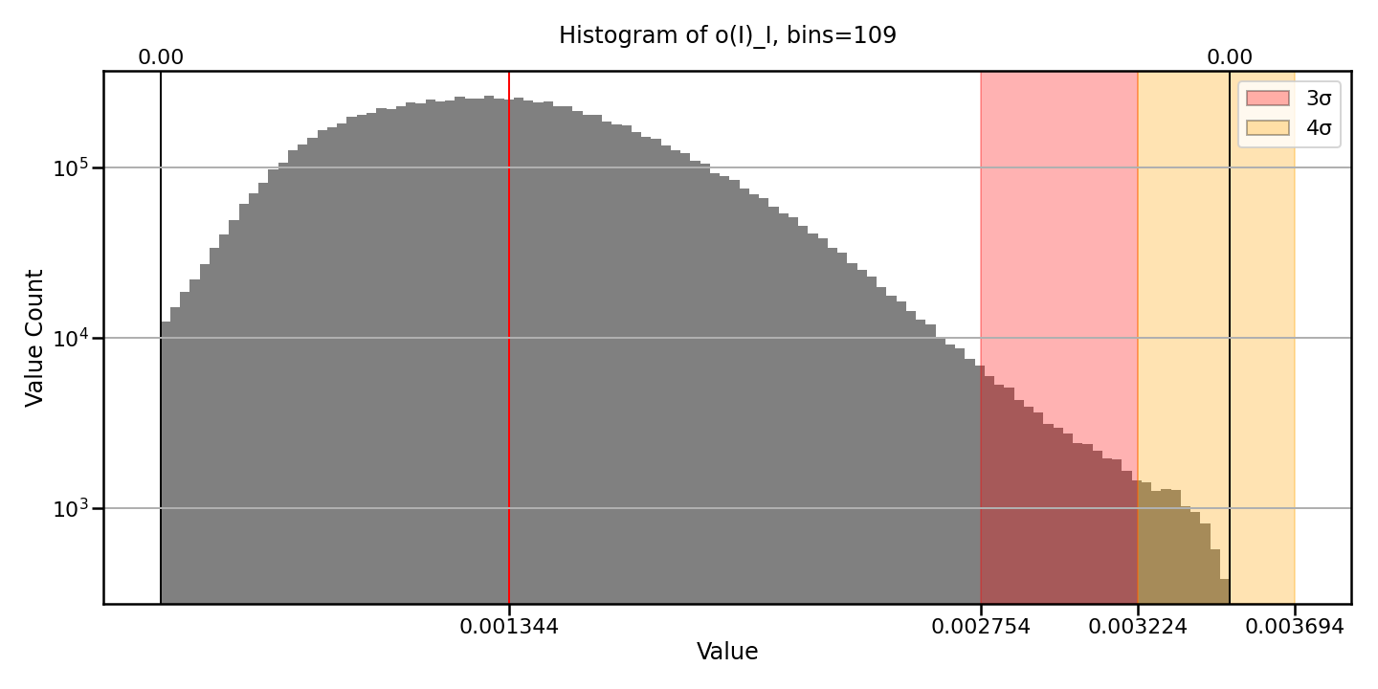
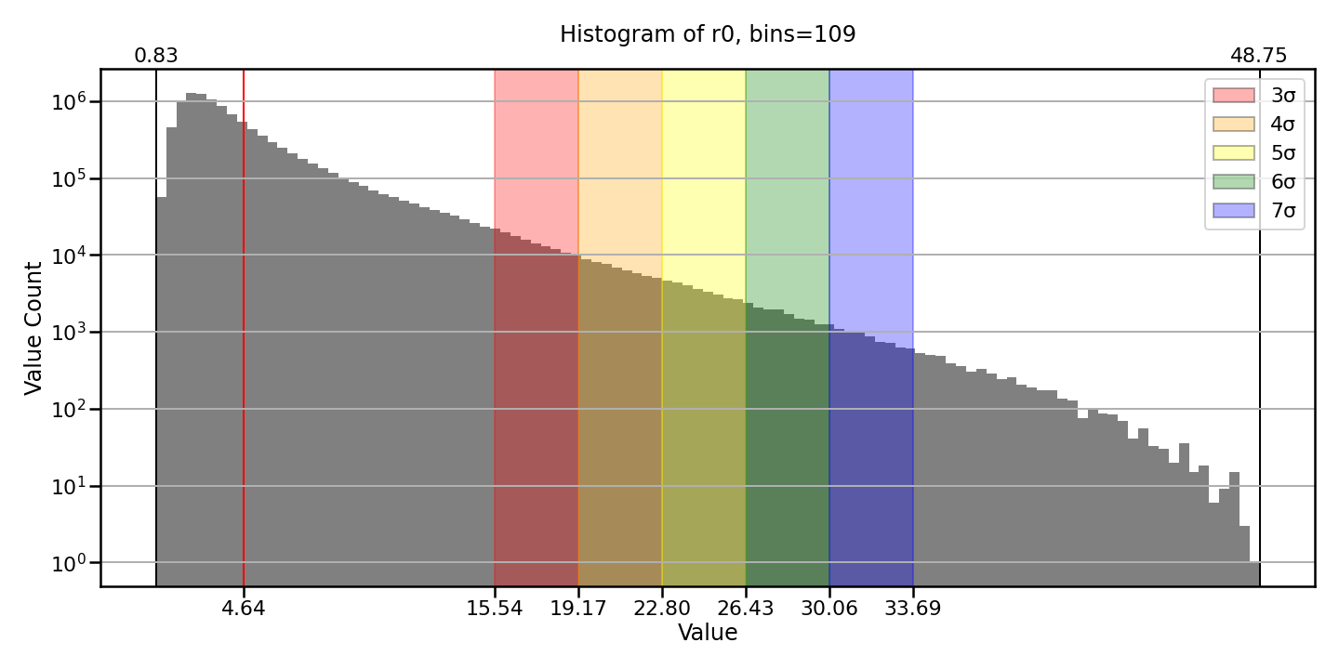
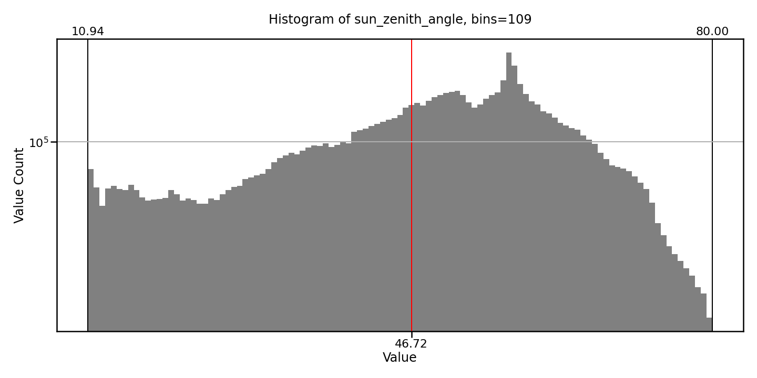
R0 Day
Only sigma regions between 3 sigma and 7 sigma are highlighted.
The red line is the mean for the series, while the black lines at each edge are the min and max. The upper x-ticks are the min/max, while the lower x-ticks are the sigma values.

Slide 15
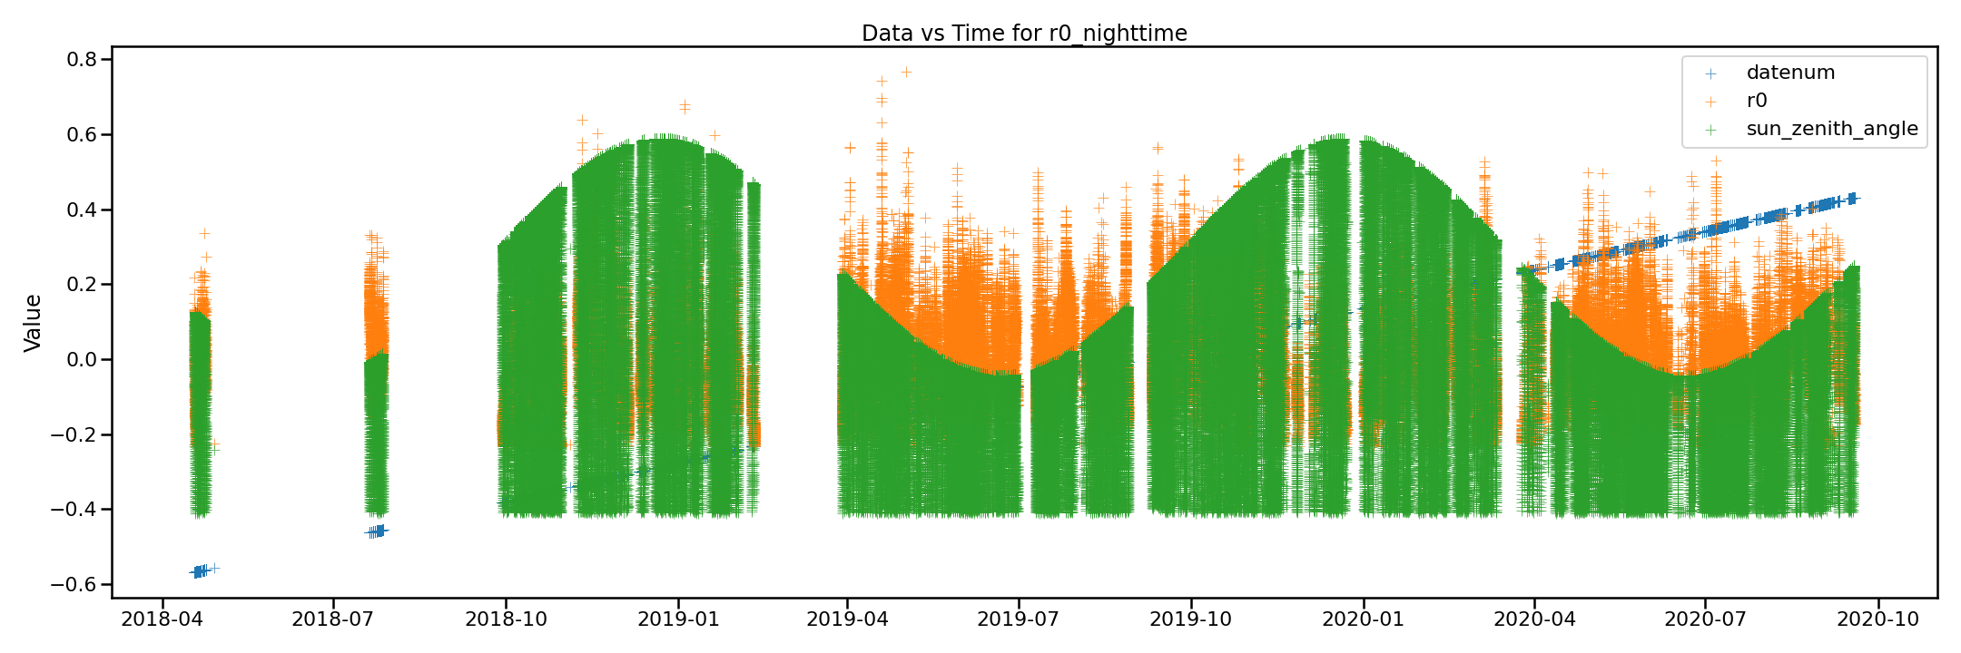
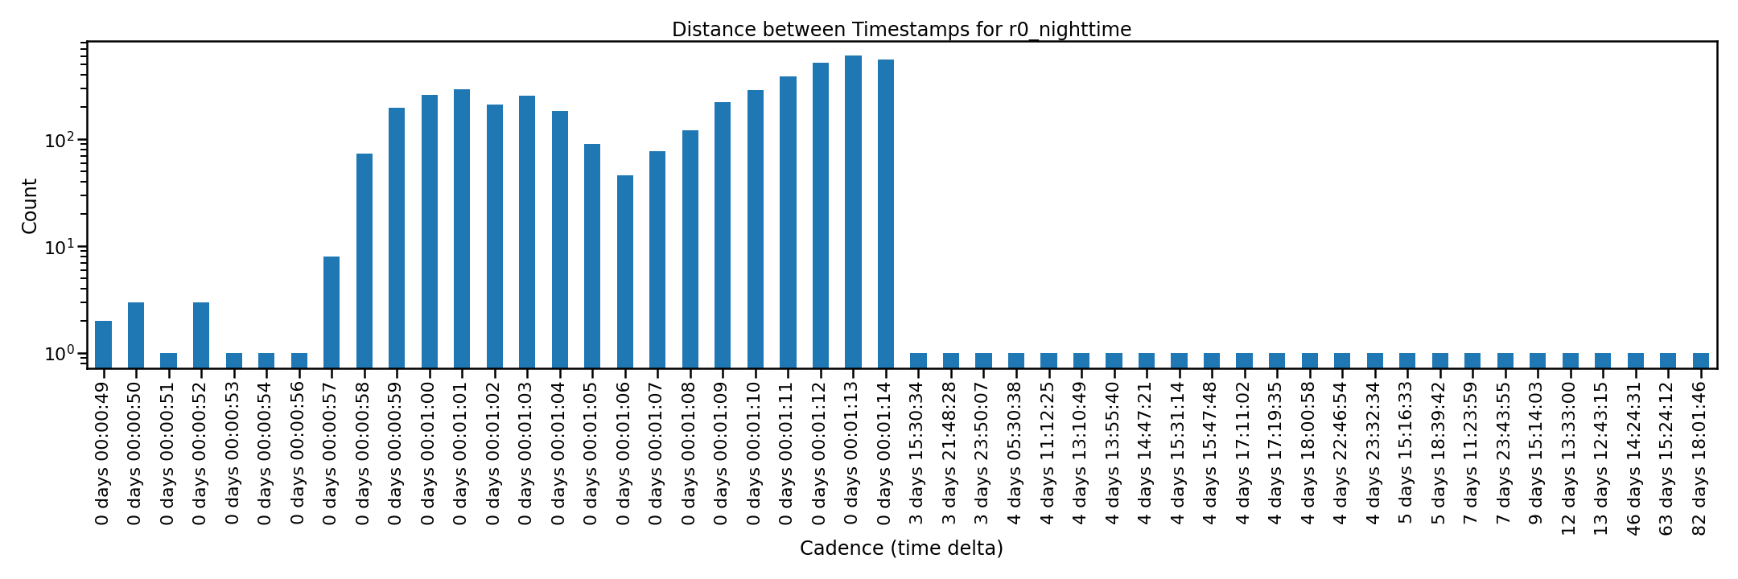
R0 Night
Ranges: 2018-04-18 05:03:01
to 2020-09-18 10:55:59
Mean cadence = 00:08:21.08
The Data vs Time plot to the right is normalized.

Slide 16
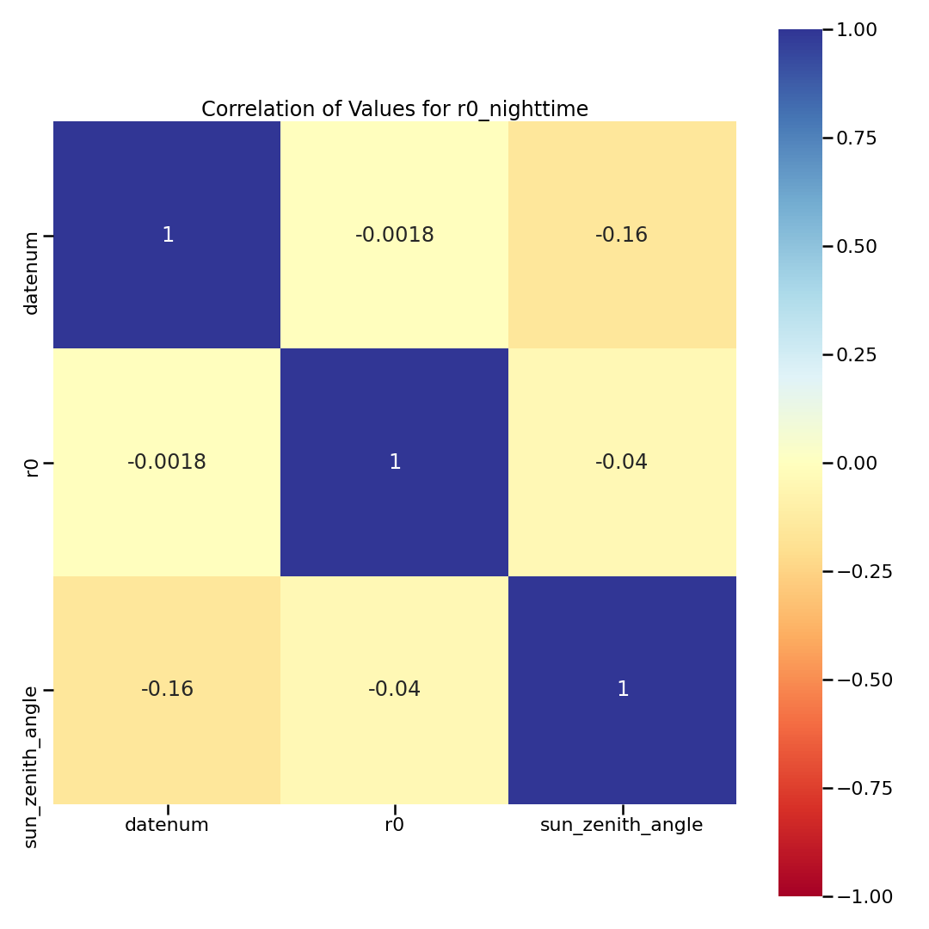
R0 Night
There were no NaNs in the columns so there is no NaN correlation heatmap
The stats below show the value and nan counts for each column. The percent row is the density percent of the column.
datenum r0 sun_zenith_angle
percent 100 100 100
total 152468 152468 152468
value count 152468 152468 152468
nan count 0 0 0
cadence mean 00:08:21.08 00:08:21.08 00:08:21.084

Slide 17
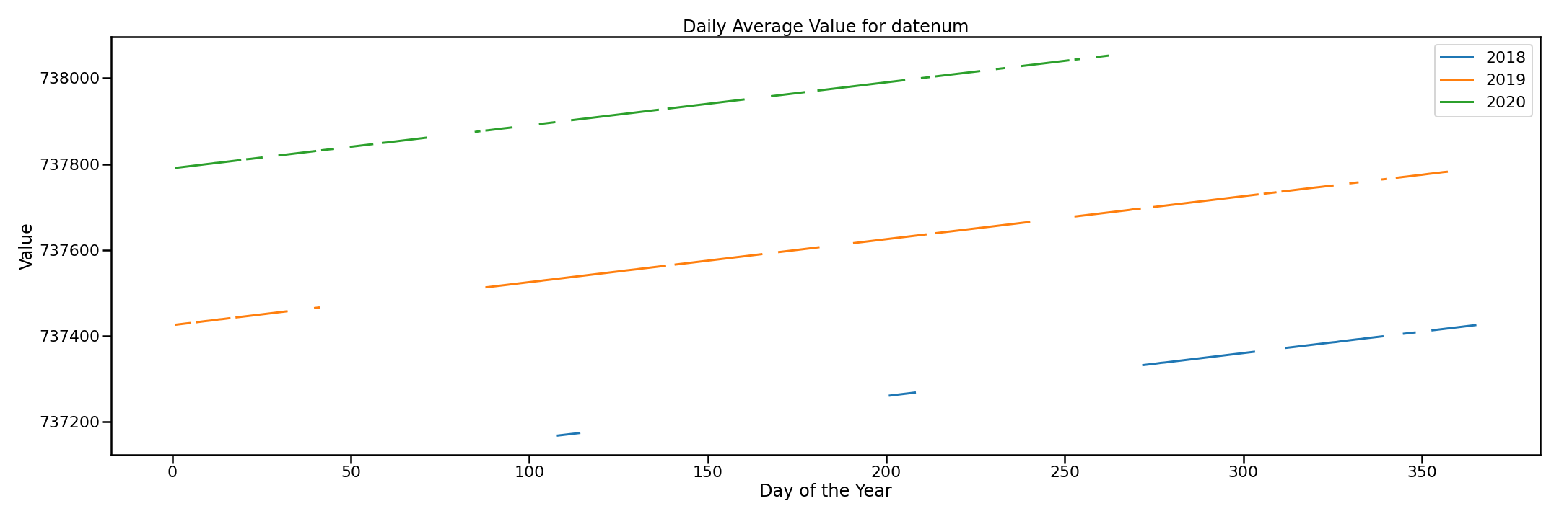

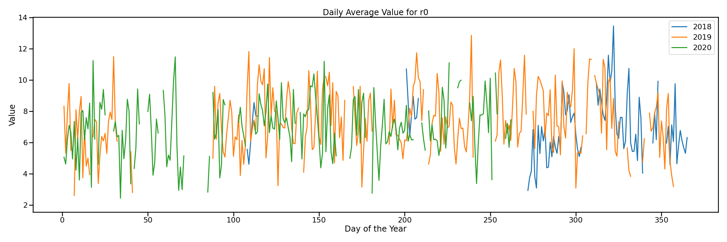
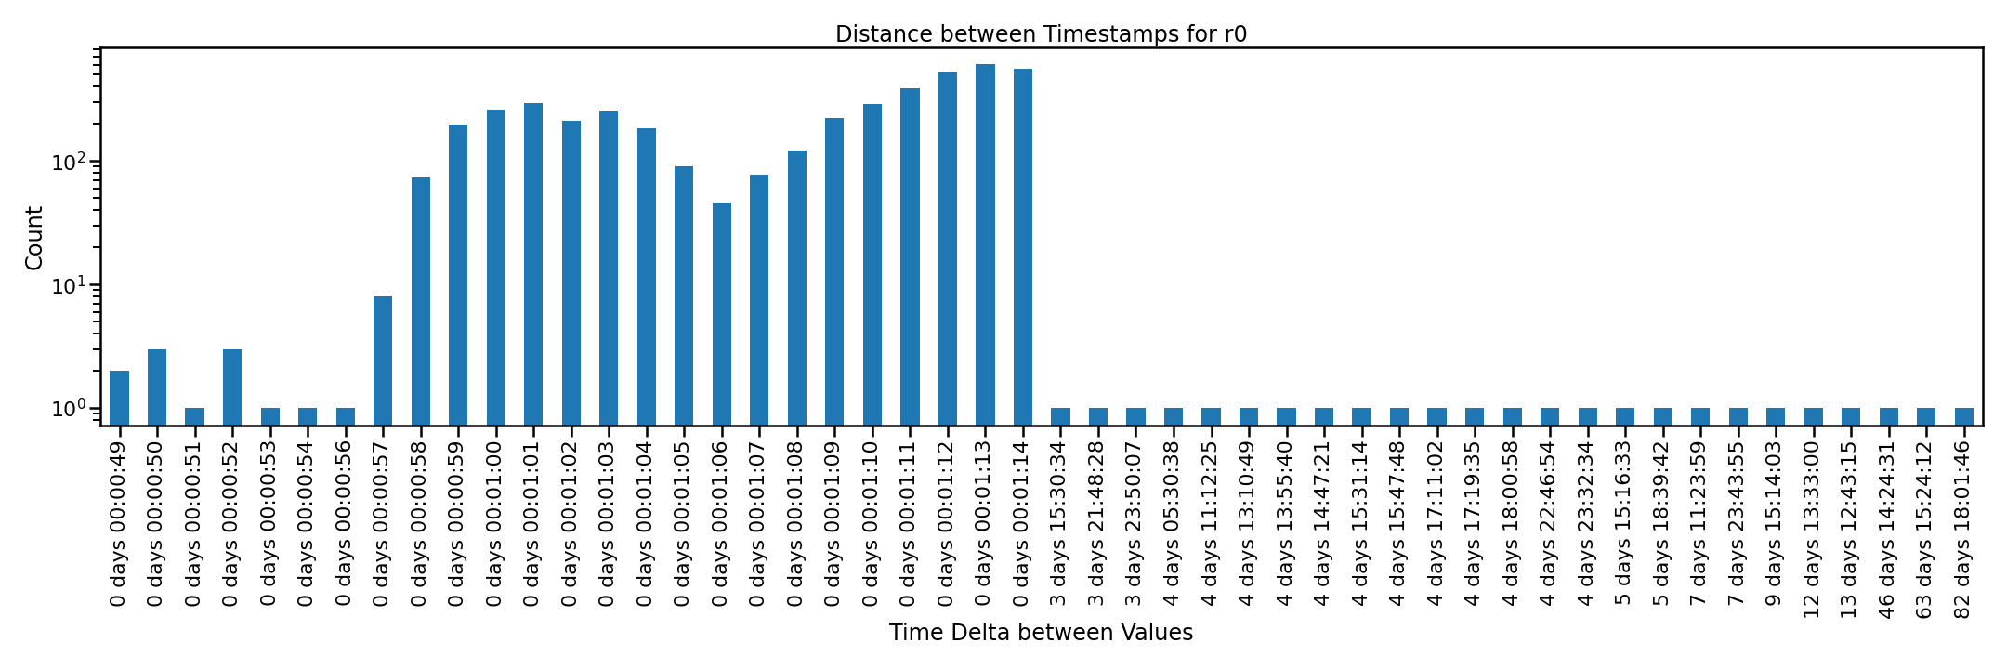
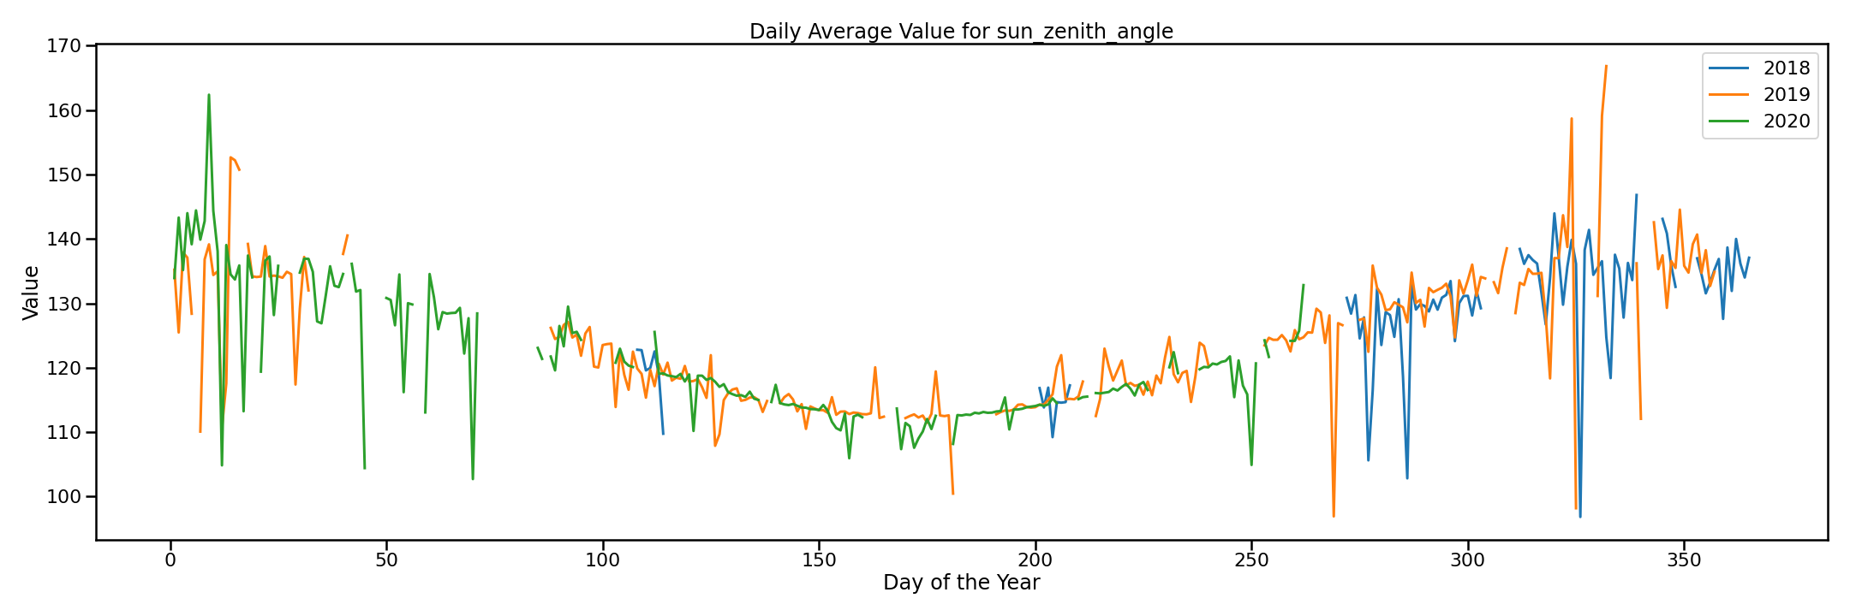

R0 Night

Slide 18
R0 Night
Only sigma regions between 3 sigma and 7 sigma are highlighted.
The red line is the mean for the series, while the black lines at each edge are the min and max. The upper x-ticks are the min/max, while the lower x-ticks are the sigma values.

